Slide 1
R6 Focused Educational Activities Webinar
December 2, 2021
Mostafa Mortezaie, Region 6 Educational Activities, STEM/K-12 Chair, mortezaie@ieee.org
(408)306-1919

Slide 2
IEEE Governance Organization
Agenda
Welcome message by R6 Director, Tim Lee (5 minutes)
EA Board Section Educational Outreach Committee Chair Message (5 minutes)
Dr. Supavadee Aramvith
R6 EA Chair highlight activities (5 minutes)
R6 Sections/Chapters EA presentation of best practices (30 minutes)
Q&A (10 minutes)
Closing Remarks (5 minutes)

Slide 3
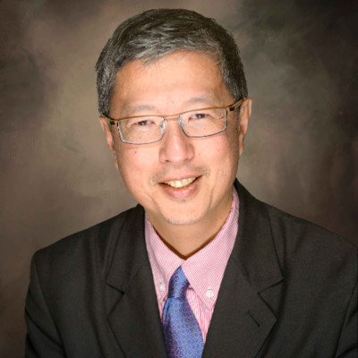
IEEE Governance Organization
Welcome message by R6 Director (5 minutes)
Tim Lee
tt.lee@ieee.org

Slide 4
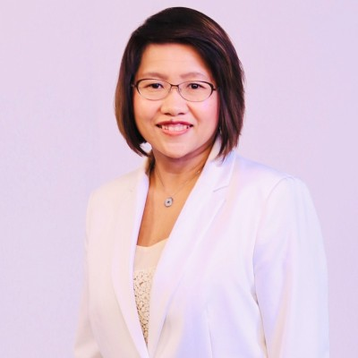
IEEE Governance Organization
Educational Activities Board (EAB)
Section Educational Outreach Committee (SEOC) Chair Message (5 minutes)
Dr. Supavadee Aramvith
supavadee.aaa@gmail.com

Slide 5
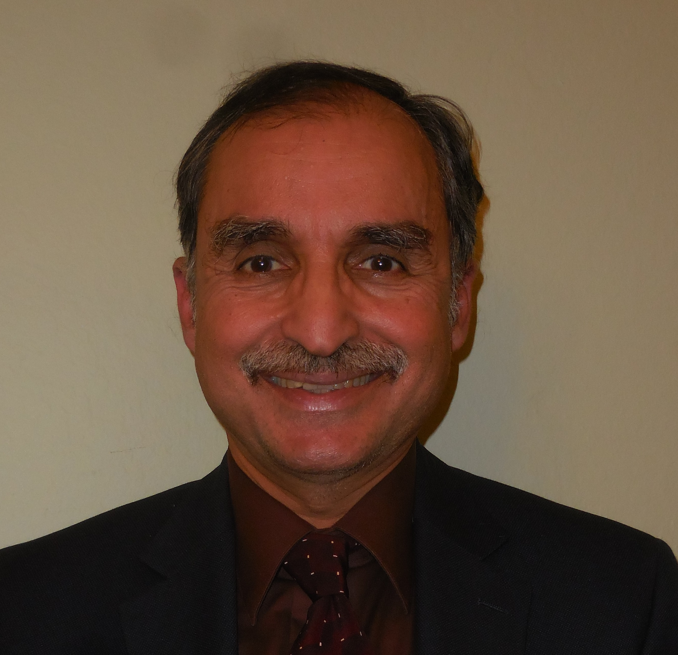
IEEE Governance Organization
Region 6 Educational Activities Chair (REAC)
(5 minutes)
Mostafa Mortezaie
mmortezaie@devry.edu

Slide 6
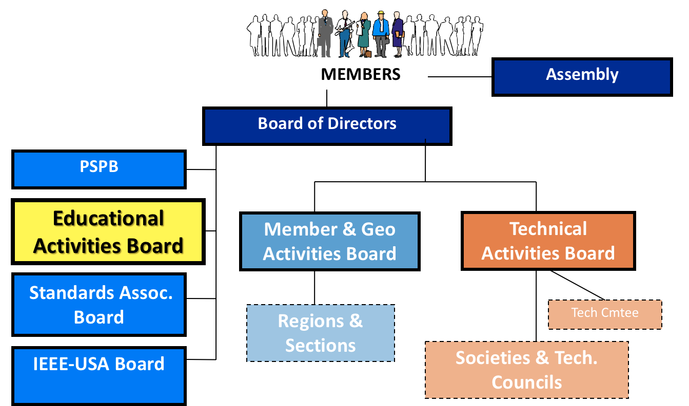
IEEE Governance Organization
Where is Educational Activities Board (EAB) in IEEE Org Chart

Slide 7
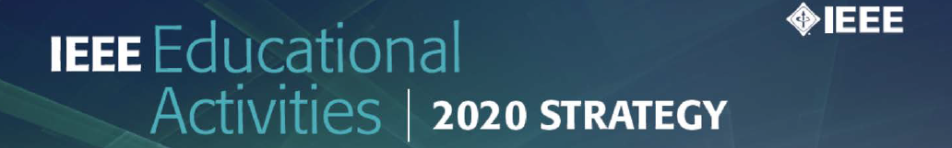
Core Purpose
To develop and deliver educational products
and services to our members, professionals,
educators, and students that excite and inspire
understanding of IEEE’s fields of interest;
support career preparation and professional
enhancement, foster diversity, and ensure
access to lifelong learning opportunities.

Slide 8





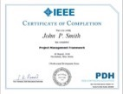

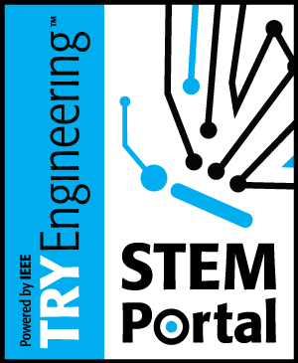

Educational Activities Priorities for 2021
1.
5.
9.
2.
6.
10.
3.
7.
11.
EAB Awards Program
12.
President’s Scholarship
4.
8.

Slide 9
Educational Activities Website
https://ea.ieee.org

Slide 10


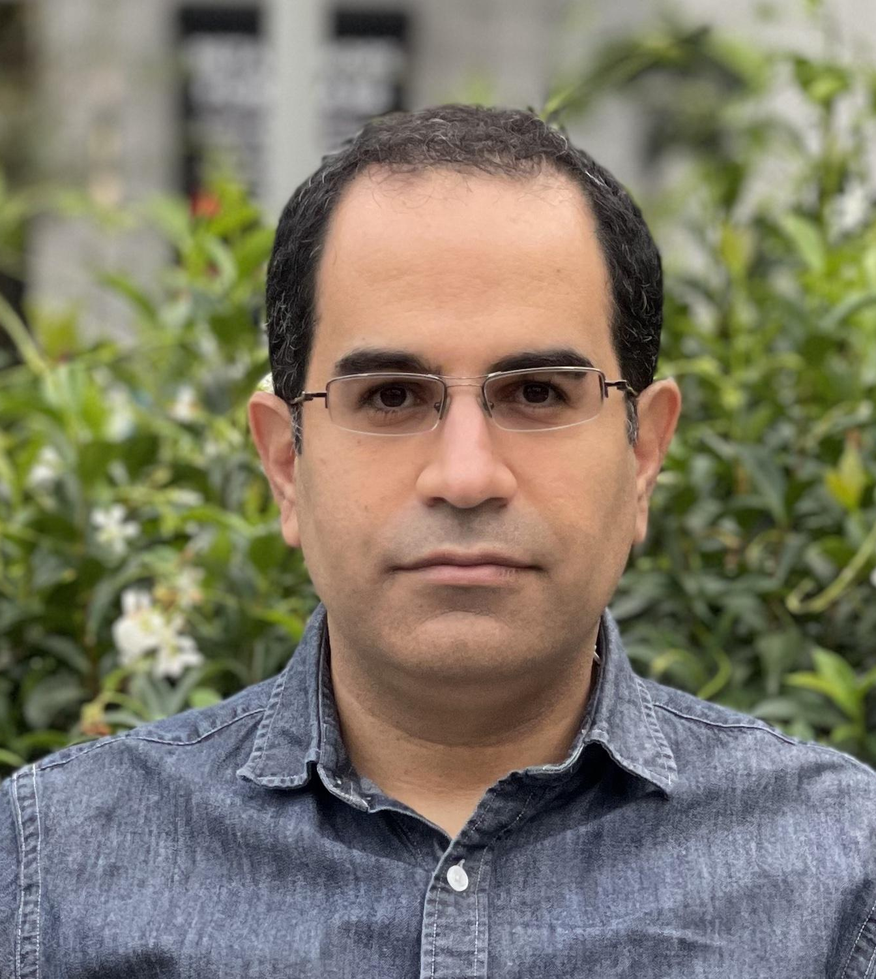
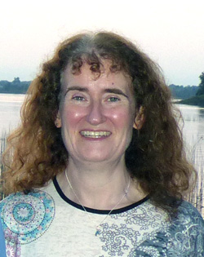
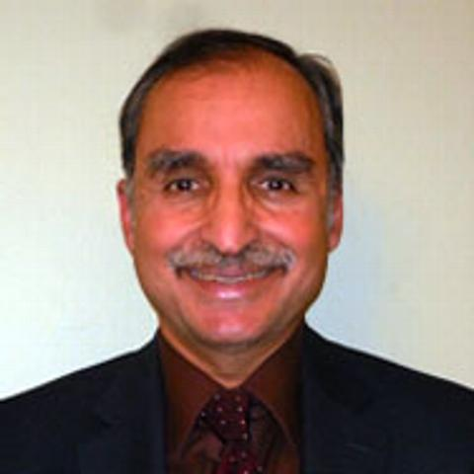

IEEE Global Humanitarian Technology Conference (GHTC)
Technology for the Benefit of Humanity | October 19 - 23, 2021
Closing Session
Behnam Dezfouli
Chair
Miriam Cunningham
Technical Program Chair
Mostafa Mortezaie
Student Poster Chair

Slide 11

Student Poster Competition
Student Poster Competition – We had eight entries from 5 countries. Thank you to all attendees, judges, and contestants.
1st Place
Investigating Clay Pot Coolers for Food Storage in Developing Nations
by Max Burns (Massachusetts Institute of Technology, MIT D-Lab)
2nd Place
Investigating the use of Wearable Technology to Improve the Safety of Humanitarian Workers in Dangerous Situations
by A. Moodie, M. Senadeera & A. van der Winden (Queensland University of Technology )
3rd Place - Tie
Monitoring Coastal Habitats Through Machine Learning
by Kalib Perkins (DeVry University)
Virtual Reality Education
by Imran Jahangir, Jay Perez, Rolando Reyes, Rohail Khan, Blien Mahari (University of Houston)

Slide 12

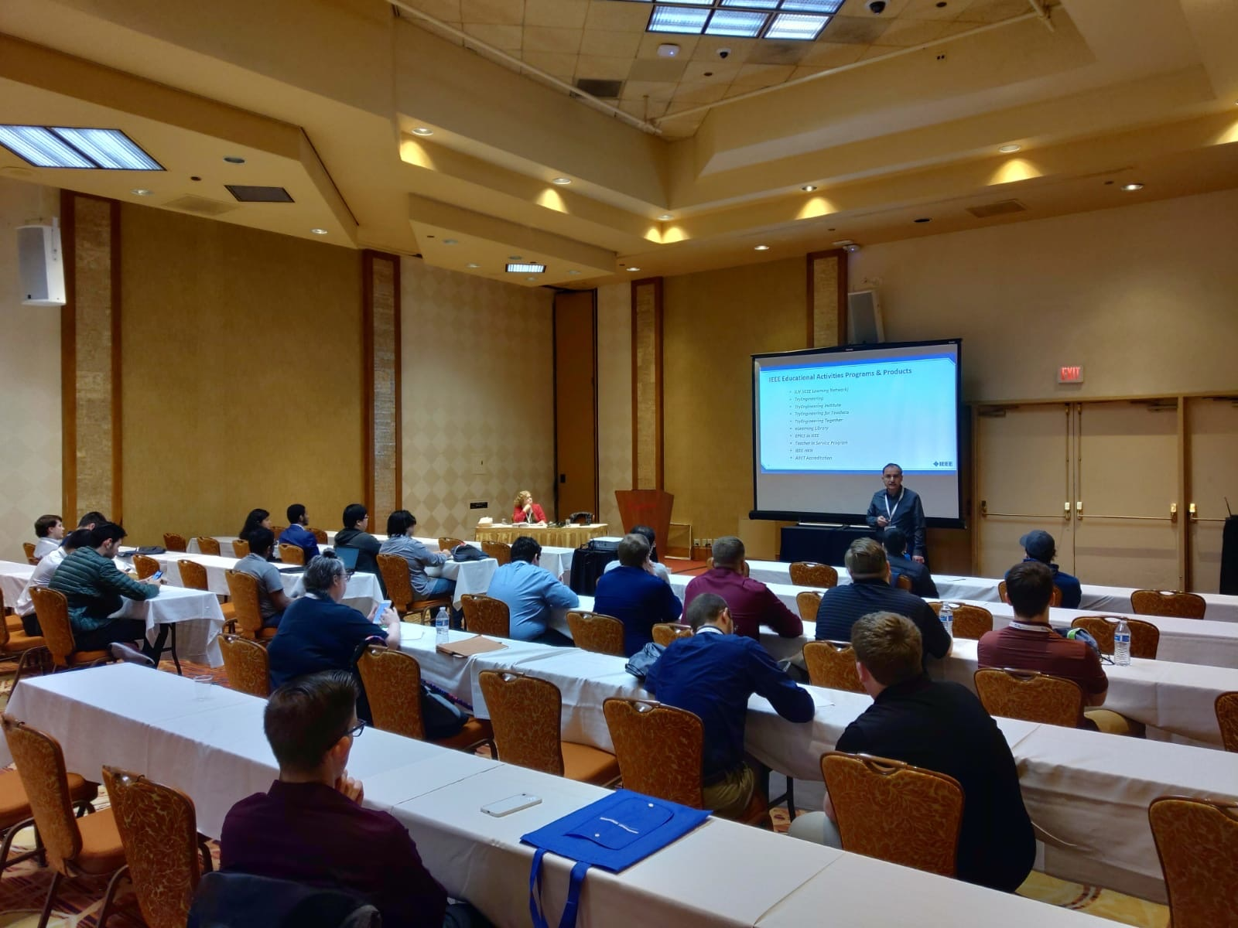
ILN Presentation at 2020 and 2021 RSC
Mostafa Mortezaie, Region 6 EA Chair
Jennifer McClain, IEEE Senior Product Manager

Slide 14



Slide 15
EA Target Objectives
Education Volunteer Resources: Website, Manual (impact, reach)
Orientation for REACs, SEACs, Education volunteers
Demonstrate EA products to SEACs: Course delivery to local members
Partnerships with internal OUs and external organizations

Slide 16
Call to Action
(Submit your Section Partnership activities with Internal/External OUs)
Identify your Section Educational Activities Chair (SEAC).
SEACs are to identify the internal and external organizations that local IEEE OUs are currently collaborating at the Section/Chapter level.
This includes academicians as well as practitioners. Examples include local IEEE Section/Chapter relations with local industry, university/colleges as well as non-profit organizations and government entities.
This information needs to be submitted into the EAB SEOC Google Drive: \
Google Form
We plan to expand this effort by nurturing current relations and establishing new contacts and collaborations in the coming months.

Slide 17
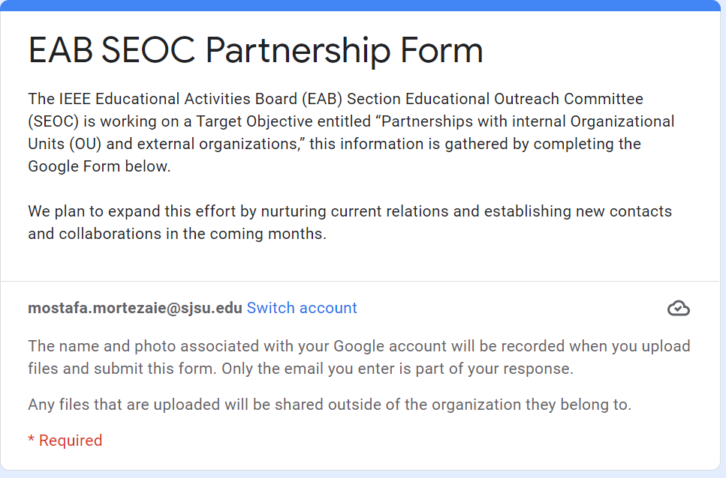
Google Form

Slide 18
IEEE Governance Organization
R6 Sections EA presentation of best practices (30 minutes)
Section | Name | Activity
Los Alamos & Northern New Mexico Section | Teresa Roberts | workshop on "how computers work" hosted by STEM Santa Fe
OEB | Rose-Margaret Itua | Ohlone College Shark Tank & Show Case Engineering Innovation for Social Justice
Utah | Chad Kidder | Educationial Activities at the Utah Section
San Francisco Section | Farid Farahmand | Sonoma State University Summer Camp
Buenaventura | Deron Johnson | Educationial Activities at the Buenaventura Section
San Diego | zhensheng zhang | Educationial Activities at the San Diego Section
Foothill Section | Max Cherubin | Educational Activities at the Foothill Section

Slide 19

Community Outreach Programs
@ Sonoma State University
Electrical Engineering Program
December 2, 2021
By Farid Farahmand

Slide 20
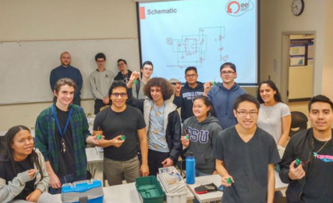
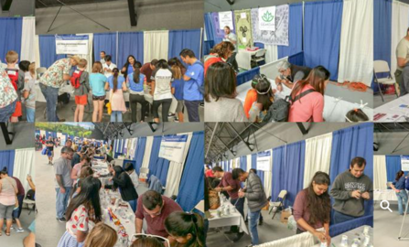
Educational Activities
Outreach to the local school & college students
  Building electronic kits with elementary students
  Soldering workshops for junior college & high school schools
  Inviting junior college students to collaborate with the engineering students at SSU with their senior design projects
Community outreach
  Participating at North Bay Science Discovery Day (every March) https://www.northbayscience.org/
  Offering workshops at the local library for elementary students
  North Bay Manufacturing day (every April) https://www.themanufacturinginstitute.org/students/manufacturing-day/
Engineering Summer camps
  Offering one-week long summer camp to high school students https://ee.sonoma.edu/engineering-summer-camp

Slide 21
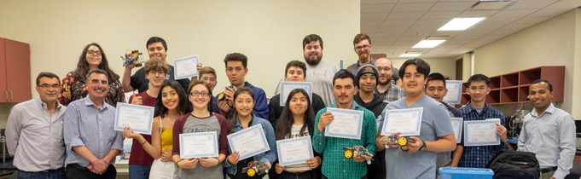
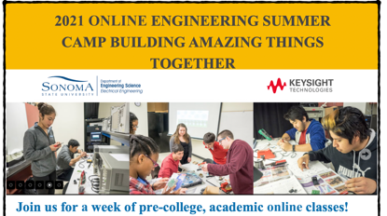
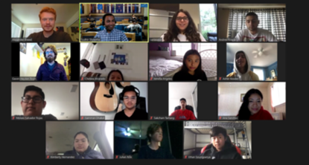
Engineering
Summer Camp
Offering 1-2 one-week long engineering summer camp
  2019: face-to-face
  2020 & 2021: Virtual
Being Supported through a grants from Keysight Technologies
  Covering food, parts, student assistants, etc.
Activities include
  Basic electronics, electronics circuits and electronic components such as batteries, motors, LEDs, buzzers, resistors, etc.
  Arduino programming and basic concepts of signal processing.
  Troubleshooting skills.
  Introduction to the Internet-of-Things.
  App development
  3D printing
  Field trips

Slide 22
IEEE Governance Organization
R6 Sections EA presentation of best practices (30 minutes)
Section | Name | Activity
Los Alamos & Northern New Mexico Section | Teresa Roberts, Hanna Ewa Makaruk | workshop on "how computers work" hosted by STEM Santa Fe
San Francisco Section | Farid Farahmand | Sonoma State University Summer Camp
OEB | Rose-Margaret Itua | Ohlone College Shark Tank & Show Case Engineering Innovation for Social Justice
Foothill Section | Max Cherubin | Educationial Activities at the Foothill Section
San Diego | zhensheng zhang | Educational Activities at the San Diego Section
Buenaventura | Devon Johnson | Educational Activities at the Buenaventura Section

Slide 23
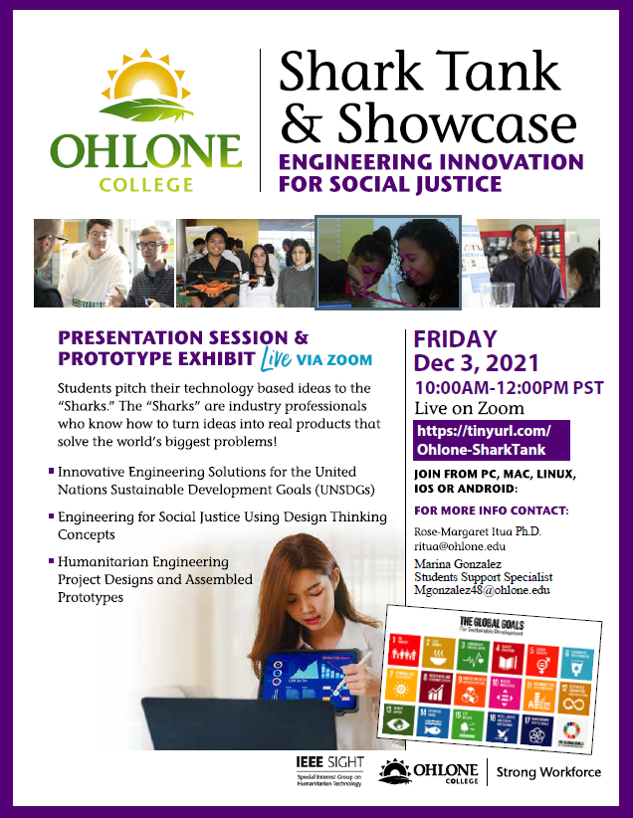
Shark Tank & Showcase Engineering Innovation for Social Justice

Slide 24
IEEE Governance Organization
R6 Sections EA presentation of best practices (30 minutes)
Section | Name | Activity
Los Alamos & Northern New Mexico Section | Teresa Roberts, Hanna Ewa Makaruk | workshop on "how computers work" hosted by STEM Santa Fe
San Francisco Section | Farid Farahmand | Sonoma State University Summer Camp
OEB | Rose-Margaret Itua | Ohlone College Shark Tank & Show Case Engineering Innovation for Social Justice
Foothill Section | Max Cherubin | Educationial Activities at the Foothill Section
San Diego | zhensheng zhang | Educational Activities at the San Diego Section
Buenaventura | Devon Johnson | Educational Activities at the Buenaventura Section

Slide 25

Resources
Educational Activities Volunteer Website
    https://ea.ieee.org/
2020 Educational Activities Board Member List
    https://rosters.ieee.org/home.html
2020 Educational Activities Committee Rosters
    https://rosters.ieee.org/home.html
2020 Educational Activities Staff Listing
    https://ea.ieee.org/contacts/educational-activities-staff-contacts

Slide 26



Join the Conversation
Facebook
@IEEEeducation
@IEEE.continuing.education
Twitter
@IEEEeducation
@IEEELearn
LinkedIn
@ieee-educational-activities

Slide 27
Questions/Comments
Mostafa Mortezaie,
Region 6 Educational Activities, STEM/K-12 Chair
mortezaie@ieee.org
(408)306-1919

